Slide 1

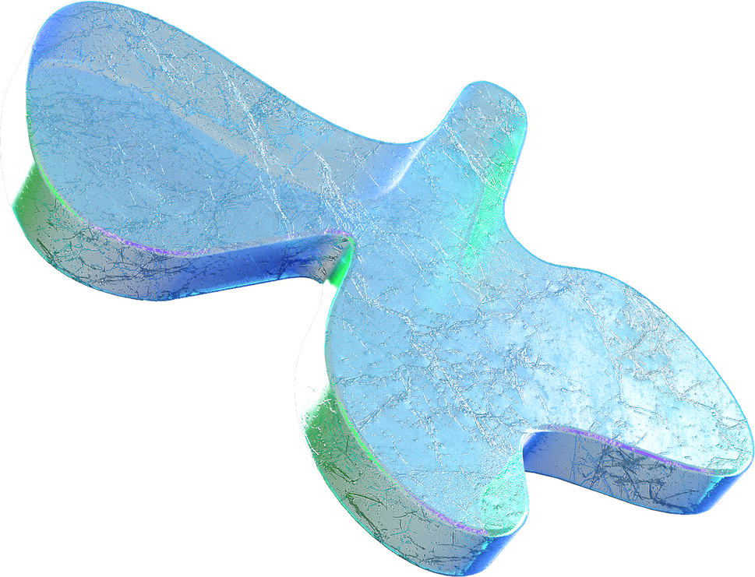
INTRODUCTION
Uniform distribution
What it is and why it's important
23071A6702- A.LOHITHA ABHIJNA

Slide 2
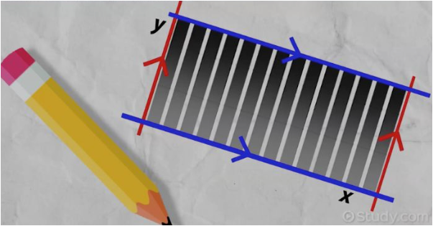
CONTENTS:
What is uniform distribution?
Types of Uniform Distribution
MEAN, STANDARD DEVIATION VARIANCE
Examples
Applications

Slide 3

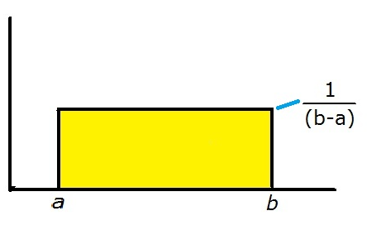
What is Uniform distribution?
Uniform distributions are probability distributions with equally likely outcomes.
It also called a rectangular distribution, is a probability distribution that has constant probability.
Has a density curve in shape of rectangle and area under it gives the PROBABILITIES.

Slide 4

This distribution is defined by two parameters, a and b: a is the minimum. b is the maximum. | The distribution is written as U(a, b).

Slide 5

TYPES:
Contiuous Uniform distribution
Discrete Uniform distribution

Slide 6
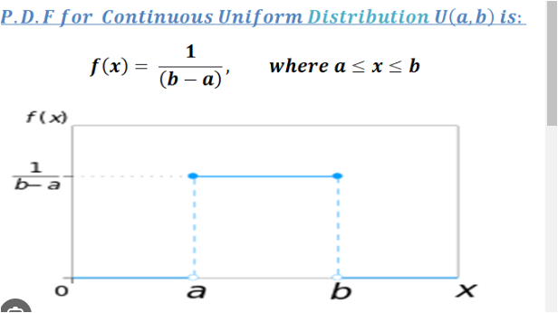
CONTINUOUS UNIFORM DISTRIBUTION
It is also called SYMMETRIC UNIFORM DISTRIBUTION.
A random variable X is called continuous uniform distribution.
The probability density function (pdf) for the uniform distribution is:
f(x) = 1/ (B-A) for A≤ x ≤B.
0 in all other cases.

Slide 7
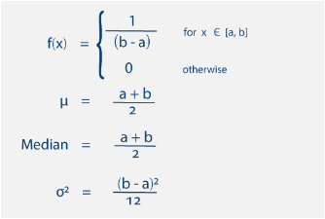
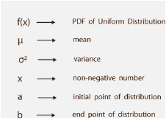
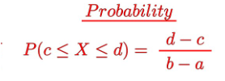

Slide 8
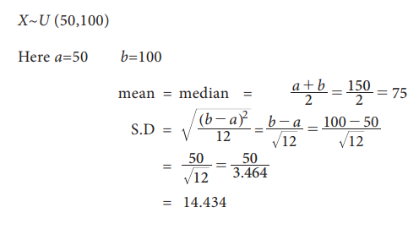
EXAMPLE:
If X is a Uniform variate with the parameter 50 and100,
find the mean, median and standard deviation.

Slide 9
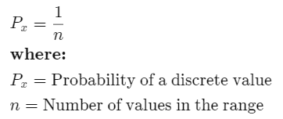
Discrete Uniform Distribution
A Discrete uniform
distribution is a statistical distribution where the probability of outcomes is equally likely and with finite values.
.
The formula for a discrete
uniform distribution is

Slide 10
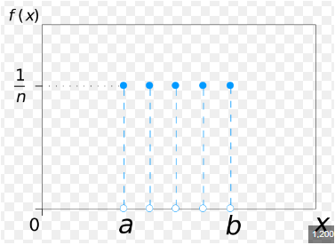
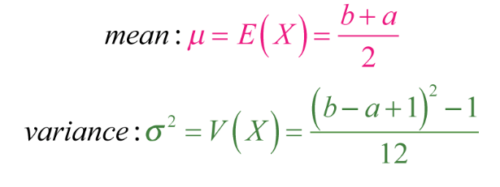
The Discrete distribution is written as U(a, b) where b>=a or unit(a,b)
n= b-a+1

Slide 11
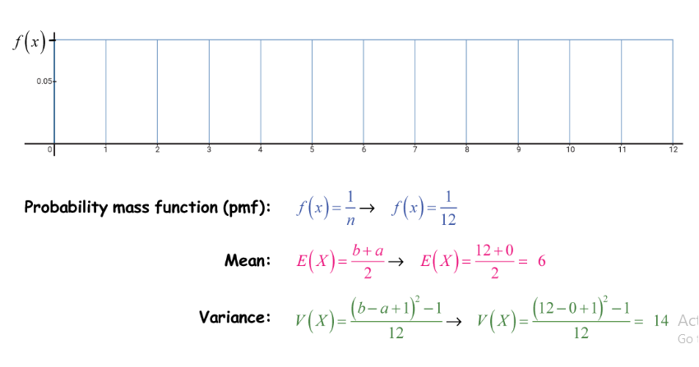
EXAMPLE
Analyse the graph corresponding to discrete uniform distrbution and find pmf,mean,variance

Slide 12
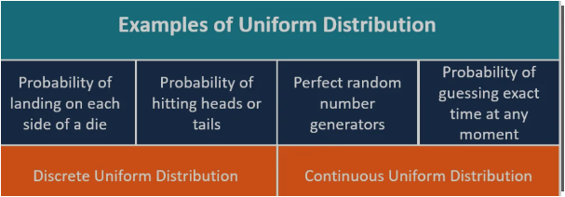

Slide 13

APPLICATIONS
RANDOMIZED CONTROLLED TRIALS:
In medical research, uniform distributions are used to randomly assign participants to different treatment groups. By ensuring equal probability of assignment, the researchers can minimize bias and create more reliable results.
Simulations and Gaming Uniform distributions are commonly used in computer simulations and gaming to generate random numbers. They are used, for example, to simulate dice rolls or generate random coordinates on a game map.
SIMULATIONS AND GAMING:
A

Slide 14
Uniform distributions play a crucial role in generating random numbers for various applications. They are used in cryptography, Monte Carlo simulations, statistical modeling, and many other areas where randomness is required
RANDOM NUMBER GENERATION:
OTHER APPLICATIONS
LOAD BALANCING
SPORTS SCHEDULING:
LOTTERY AND GAMBLING

Slide 15
CONCLUSION
It is expected that a uniform distribution will result in all possible outcomes having the same probability. The probability for one variable is the same for another.

Slide 16


THANK YOU..!
I hope you learned something new.

